Slide 1
Volunteer Me
Group B3
2080613 Seoras Macdonald
2084246S Rhianna Jade Scott
2063602 Charles Henry Thomas Townley

Slide 2

Name: James
Category to Volunteer in : Administrative work
Occupation: Student
Volunteer Time : evenings and weekends
Ares willing to travel to: West of Glasgow
Description:
Has class during the day but wants to volunteer to further his career and cv.
Has experience working with the basic administrative tools.
Would like to volunteer in a charity store or organisation aimed towards helping the sick
Willing to travel but prefers to stay in the west of Glasgow
Storing personal details
Storing details of the times he is available
Searching for opportunities in the chosen field/area/time
Storing searches
Applying easily without filling out the form more than once
Finding out if he has been accepted.
Replying to organisers

Slide 3

Name: Glasgow Royal Infirmary
Area: East Glasgow
Area of volunteer: Charity shop/retail, catering, Administrative/Office work
Description:
The hospital needs volunteers to run the small store that runs from 9am – 4 pm, volunteers that will help in the cafeteria and volunteers that will help with paperwork and basic administrative tasks
They would like experience but are willing to train people on a case by case bases
Daily tasks
Catering – Setting/ cleaning tables, Washing dishes, Setting up and closing down, Helping cook
Admin – basic tasks.
Retail - basic customer interaction, sorting and storing items, opening closing the store,
Making the each opportunities available quickly and easily
Reviewing the volunteers that apply for it
Contacting the volunteers
Changing the details/deleting of each opportunity as places are filled
Adding other opportunities as they become available
Renew old opportunities

Slide 4
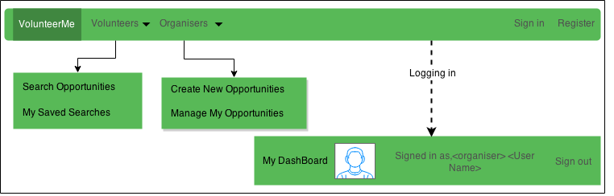
Header bar
Inauthenticated users see the top bar.
Can click on either “volunteers” or “organisers” to see relevant links.

Slide 5
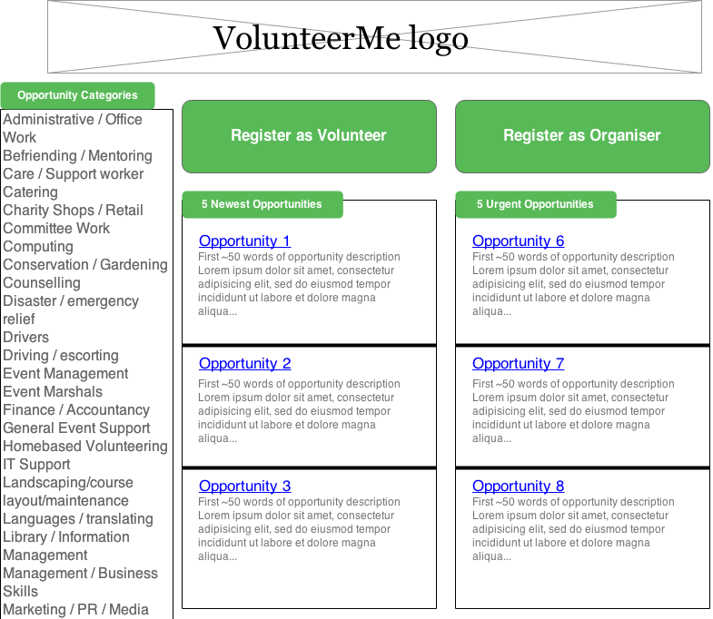
Unauthenticated Main Page
Buttons to register as either a volunteer or an organiser
List of opportunity categories on the left side
2 lists of opportunities
5 most recently added opportunities
5 opportunities ending “soon”

Slide 6
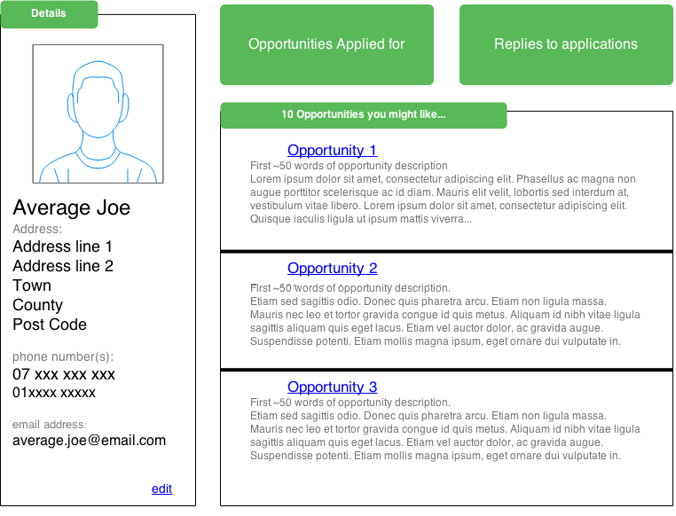
Dashboard (Authenticated main page)
Your Details (at a glance)
Link to view your applications
Link to notifications about your applications
10 suggested opportunities

Slide 7
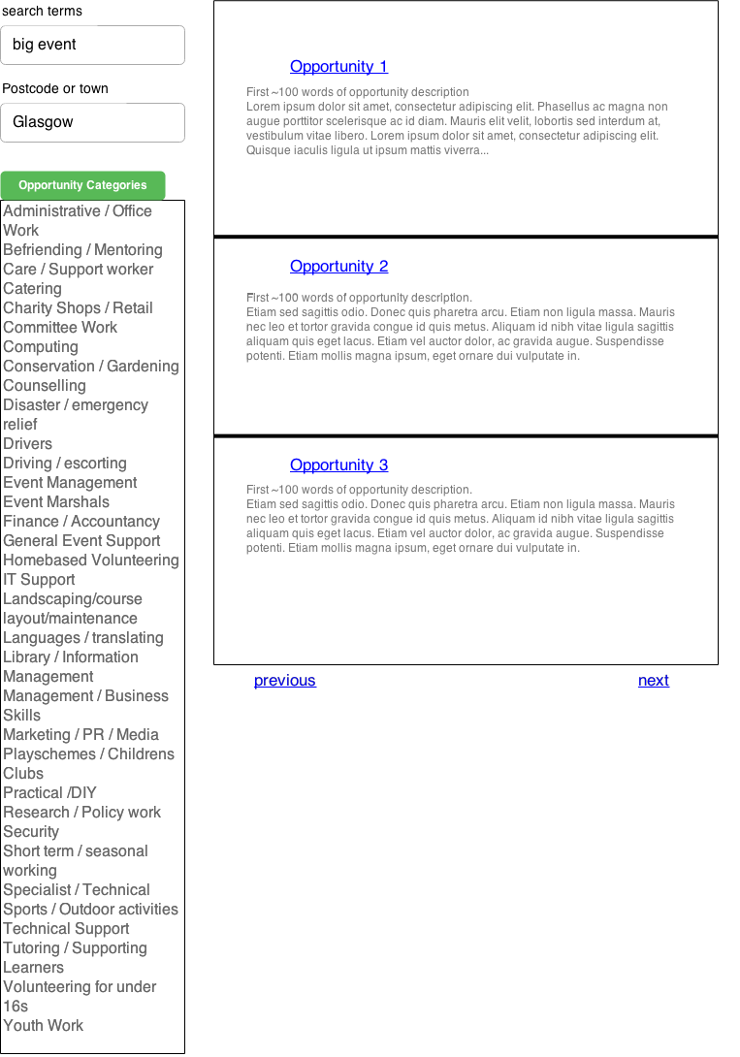
Search Page
Description Key word search
List of categories
Opportunities matching searches
~10 to a page

Slide 8
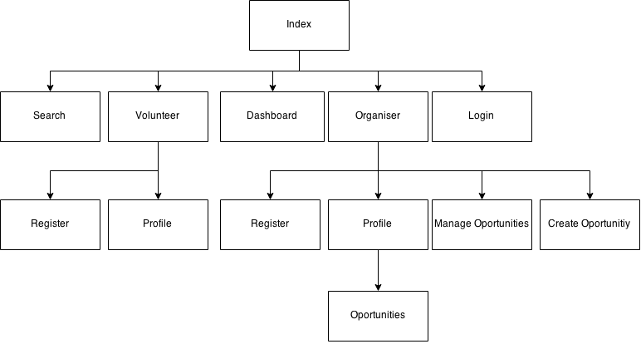
Site Map:
www.volunteerme.com/
www.volunteerme.com/search
www.volunteerme.com/login
www.volunteerme.com/dashboard
www.volunteerme.com/volunteer/<volunteer>
www.volunteerme.com/volunteer/register
www.volunteerme.com/organiser/register
www.volunteerme.com/organiser/<organiser>
www.volunteerme.com/organiser/<organiser>/<opportunities>
www.volunteerme.com/organiser/manage-opportunities
www.volunteerme.com/organiser/create-opportunities

Slide 9
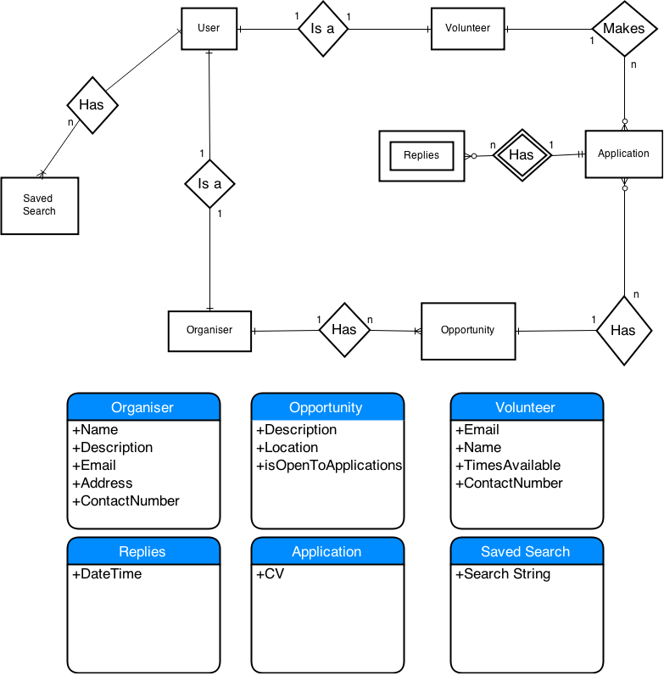
ER diagram

Slide 11
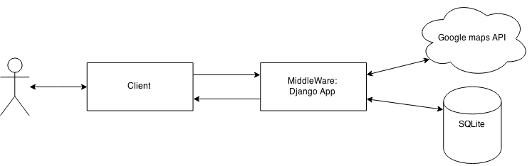
N-Tier Architecture
Google maps API included for some location search functionality

Slide 12
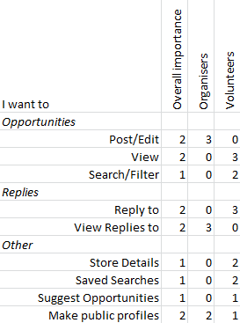
User Needs Matrix
Volunteers:
Need to view and reply to opportunities
Want to search and filter opportunities and avoid typing in the same data over and over again
Like to have a public profile and know about opportunities they might not find
Organisers:
Need to tell people about their volunteering opportunities and see who has replied to their opportunities
Want to have a public “face” on the site

Slide 13
Specification list:
Must be able to
Volunteers
Volunteer for opportunities
Including their personal details.
Search/Filter/View opportunities
Organisers
Post/Edit/Delete opportunities
Create/Maintain public profile
View replies

Slide 14
Should be able to
Volunteers
Save searches
Store/Edit personal details
Name, Email, Phone no., CVs
Organisers
Edit/create details for accounts
Renewing old opportunities

Slide 15
Could:
• Organisers can see how their opportunity is being seen by volunteers
• Map separated by county then smaller regions
• Mass contact tools for organisers

